Slide 1






Gender-Based Violence Information Management System
Erin Kenny and Diana J. Arango, UNFPA
on behalf of the GBVIMS Steering Committee
www.gbvims.org

Slide 2
Meeting Objectives
  Enable understanding of best practices reinforced by the GBVIMS
  Enable understanding of the GBVIMS, including its capacity and limitations
www.gbvims.org

Slide 3
Background for the GBVIMS
Need for effective and safe storage, analysis and sharing of GBV-related data.
Need for a reliable picture of GBV being reported
Minimal utility of data to inform program decisions
Poor data = poor program monitoring = less effective prevention and care for survivors
Limited data/information sharing among key stakeholders (for good reasons) – affects GBV coordination and limits a multi-sectoral response.
www.gbvims.org

Slide 4

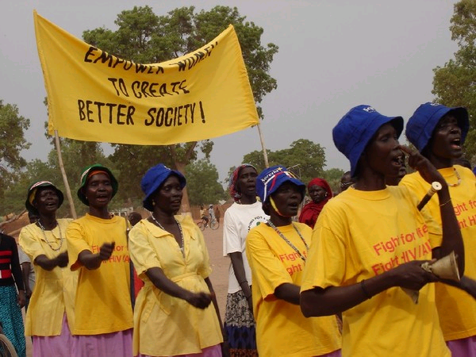
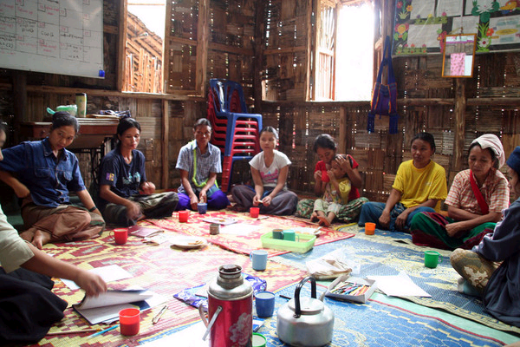
One piece of the data puzzle
www.gbvims.org
Notes:
So just what is the GBVIMS?
The Gender Based Violence Information Management System is a data management system that will not solve case management needs, but was created to improve Gender-Based Violence prevention, response and coordination in humanitarian settings.
It was specifically designed for:
Service providers who deliver case management, health, or psychosocial services to GBV survivors, and
Agencies coordinating the response to GBV in humanitarian settings.
The GBVIMS enables:
Humanitarian actors who are providing services to GBV survivors to safely collect, store and analyze reported GBV incident data using standardized tools and methods, harmonizing GBV data collection in humanitarian settings
The Safe and ethical sharing of reported GBV incident data

Slide 5
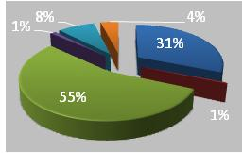
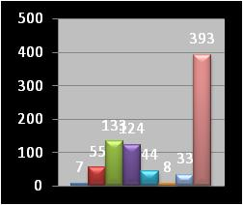
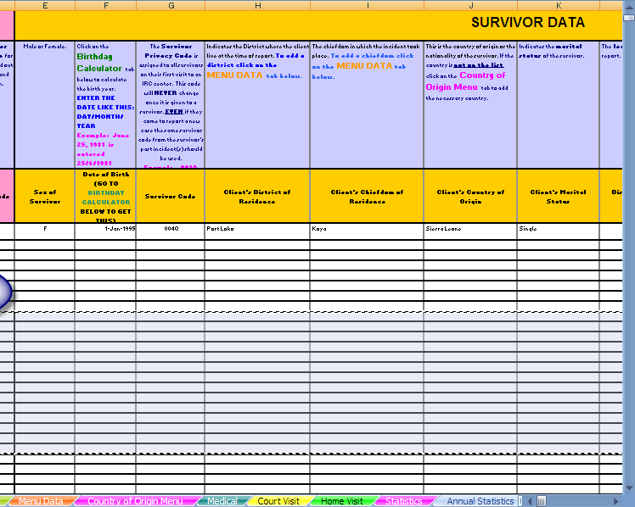
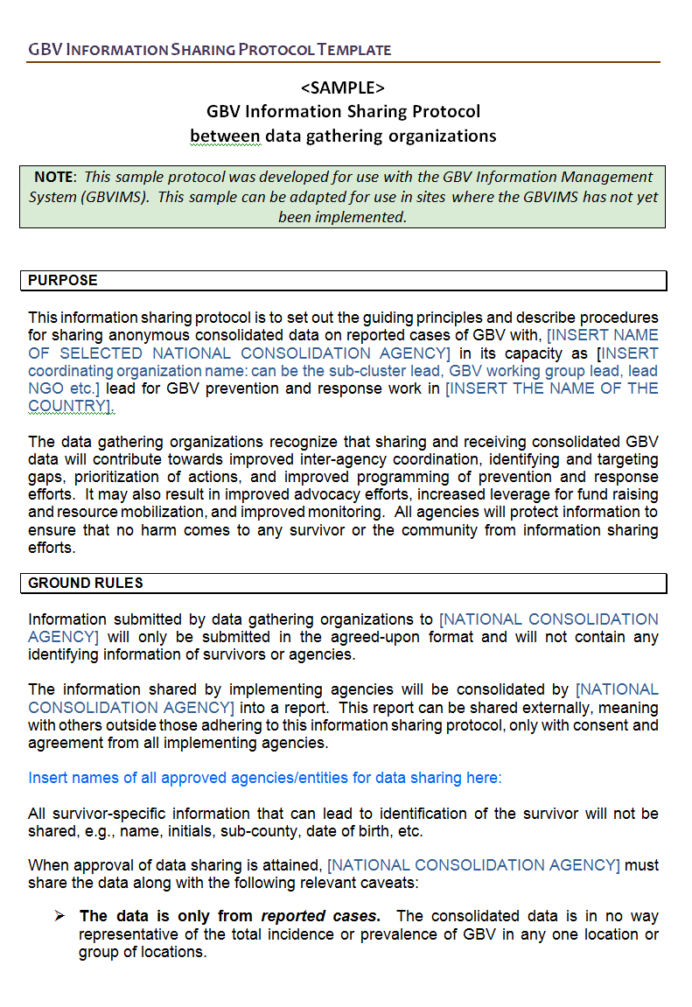
Data Analysis
The Intake Form
Reports & Proposals
Program Design
GBVIMS Data Informs
The Incident Recorder
Advocacy
The Information Sharing Protocol
A Standardised Process
www.gbvims.org
Notes:
So how does the GBVIMS provide a simple and effective system for GBV project managers to collect and analyze their data?
The basis for data input in the GBVIMS will be the incident report or intake form. All data that you enter into the database should have its origin in the form. Only specific data collected in the incident report form will be transferred into the GBVIMS database and shared. Once compiled between actors, the consolidated data will serve as the basis for subsequent statistical analysis generated by GBVIMS. These statistics in conjunction with qualitative analysis of specific program circumstances, will provide a basis for GBV program planning, monitoring and advocacy.
Lets quickly look at the characteristics of each component.
Data Compilation & Statistical Analysis
Using standardized incident report forms and a globally-standardized incident classification system, GBV primary service providers can enter data into the Incident Recorder and run instant analysis to identify correlations between data fields, revealing trends in their reported data. These automatically-generated reports include analyses on the incidents, survivors, and to a lesser extent on the perpetrators. They also include a snapshot of referral actions taken. Examples of the types of information provided by the Incident Recorder include: the most-commonly reported types of GBV incidents; the most-affected age groups of survivors; and, the type of service that is most often the first point of entry for survivors (e.g. health, police, legal services, etc…).
Data Sharing
Providing a safe and ethical mechanism for primary service providers to share and access compiled GBV data is one cornerstone of good GBV coordination. At a minimum, actors should be clear on what data will be shared, for what purpose, who will compile the data, and how and when actors will be able to access the compiled statistics. The GBVIMS Incident Recorder anonymizes and standardizes reported GBV data in order to facilitate sharing of sensitive information between humanitarian actors in a safe manner. Comprehensive guidelines for developing data-sharing protocols, as well as information on all of the ethical and safety issues that must be considered before sharing data are an integral part of the GBVIMS project.

Slide 6
The Intake Form
  SURVIVOR INFORMATION
  REFERRAL TYPE
  DETAILS OF THE INCIDENT
  PERPETRATOR INFO.
  PLANNED ACTION
  ASSESSMENT POINTS
www.gbvims.org
Notes:
Systematized definitions and categories ensures a minimum data set collected by all providers
The order of the form and all categories match the data columns found in the Incident Recorder, making data entry as easy as possible
Limited fill-in-the-blank entry, to save time on data entry and avoid errors (uses tick boxes)
Collects all data necessary for the optimal functioning of the Incident Recorder
The form includes a confidentiality statement that request the permission of the survivor for the sharing of unidentifiable data on her or his case.
Although the data is confidential it will be reported on using aggregate formats - which means it will be anonymous, enabling its safe sharing

Slide 7

GBV Classification Tool
www.gbvims.org
Notes:
If we want our incident data to be consistent and comparable
Everyone must use the same incident categories & definitions to classify a GBV incident.
6 Core Incident Types
Rape
Sexual assault
Physical assault
Forced marriage
Denial of resources, opportunities and services
Psychological/ emotional abuse

Slide 8
The Incident Recorder and
Data Analysis
  Safely stores standardized data
  Facilitates data entry and analysis
  Enable sharing of quantifiable elements of anonymous incident data
  Create aggregate statistics to determine correlations between characteristics and circumstances of GBV incidents
www.gbvims.org
Notes:
Key Features of the Incident Recorder:
Based in Microsoft Excel
No learning new software programs
-If you have never used Excel before, you will only need to learn a few easy commands to use the Incident Recorder
- Uses data from the Standard Intake / Initial Assessment forms
- Easy to enter data
- Anonymizes data for safe sharing
Is protected
Formulas automatically calculate values, produce charts and graphs that facilitate data analysis
Lets take a quick look

Slide 9
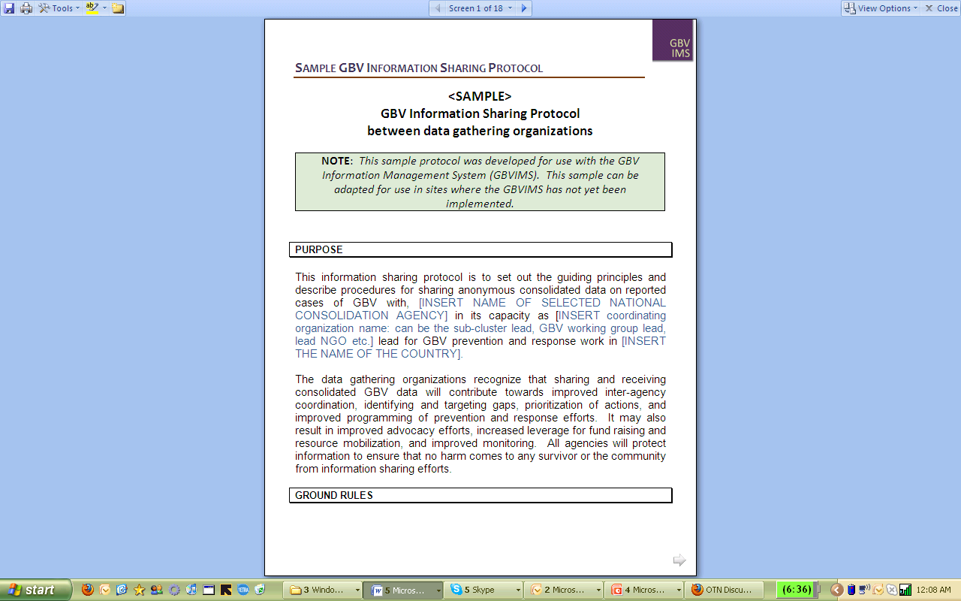
Information Sharing Protocol:
Our Key to Letting Data Flow
www.gbvims.org
Notes:
Inquiries into sexual violence incidents are extremely sensitive.
Collecting and sharing information on GBV can be dangerous, even life threatening to survivors, communities, and those involved in collecting the information.
There are many ethical and safety issues that must be considered and planned for in advance.
Questions to consider when before sharing GBV data.
What is the purpose of the proposed data collection activity?
How likely is it that the data collection and analysis will achieve the intended purpose?
What are the likely risks to survivors, their families, supporters, and communities?
What are the likely risks to those involved in the proposed data collection activity?
How can the above risks be minimized?
Will this population benefit directly from the end result?

Slide 10
Establishment of Good Practice
  Service provision must be available to GBV survivors if data is going to be gathered from them
  An agreement is established in collaboration with service providers to determine how data will be shared, protected, used and for what purpose
  Survivor/incident data is shared only with the informed consent of the client
  Survivor/incident data is de-identified
  Client case files are only shared within the context of a referral and with the consent of the survivor
  A service provider requires the most data to do their work. A lot less data is needed by everybody else.
www.gbvims.org
Notes:
Eliminating persistent bad habits:
Casual approach to storing data
Sharing client data without their informed consent or knowledge
Sharing too much data
Sharing identifying data
Sharing data without considerations as to how that data will be used
Mandatory sharing of individual client case files

Slide 11
Thank you

